Slide 1

JAVA BASED SCIENTIFIC CALCULATOR
Team Members:
Tizil Kumar
Jayant Pathak
Aryan Nath
Priyam Soni

Slide 2
CONTENTS
Introduction
Bosics of Scientihc Calculotions
Ç. Design and lmptementatîon
@, ÄdVanced Featureä
D, Testing ond Validation
@ Deployment ond Distribution

Slide 3



LOGO
Introduction

Slide 4
Importonce of ScientiŃc Colculotors
lsh aJ1 powerpoint desig n
Usoge in ocodemio
łshejl powerpoint design
isheji powerpolnt desłgn
Stuclents and professors utilize scientific calculators for problem- solving across various subjects, enhancing learning through practical computations in mathematics, physics, and chemistry.
Scientific calculators facilitate complex calculations, enabJing researchers to perform statistical analysis, clata modeling, and simulations with accuracy and efficienc y in experiments.
In engineering. scientific calculators are c fucial for design calculations, structural analysis, and electrical engineering problems, streamlining processes and reducing human error.

Slide 5


Overview of Java
Introduction to Java
Java for scientific computation
low is c high- legal, versorile pforjt'ommIng longuogo kiJcwiJ for ita piIoTfofm inQ+penoanc e, widespread use. and srtonj community support, making It ioeoi fof vatloua opplicotons.
Java offets librotles oi\d frameworks Quired for sciDnt*fic computing. enabling deveopet a to perform numaticol mernods oota an'aIysia, and grophicot teprasentaric•n of scientific ooto oMcientI-y.

Slide 6




Blne, coslna, ond
jnnerse
trlgonometrlc. lunctions
Inverse:'trIgonometric functions provide the ongle meosurés sorr'es'ponding to given ratios of sible lengths. incIudin'g orcsiné, orccosine. and orctongen\ esseritial fo'r solving triiarigle- reIate'd problems.
tongent
Sine, .üoslrie, on:ó tongerit ore primari. trigonometrid functiòns relatlng angles to slde lengths in right- ongled Iriangles. They ore fund.omental in geometry, ph'/sic's, and engfneering opplidotions.
Hyperbdlic functióüs, such os èioh onó cosh. èAend trigonometric principles to hyperbólas. They ploy crriciol ro¡es iii colculsóons invo'1ving. hyperbolic geor'neIzy, erigineering. and physic's', poniculórly iri wm'e and heot equotions.

Slide 7


Mothetnoti«ol Operation»
@
subtroctlon
Multiplication and dfvtslon
Multlpllcotlon is repeated addition of a number: resuhing In a proa» t whereas divlslon Is the process oi determiñing how mony timed oné
number 1s contained within onsrher, yieldln₉
Quoñ•nt
Addltlon
Additbg ln,olveecoménlng numbqmtogoouceo sum.ilgeubeo fonsmñepopesdtownggme numbelovmyhomonomm.+b€ng mo
.die mc .Box opeâaonaoreJUnUomenio to
Exponential functions 1nvoIve variables in the exponent showcosing rapid growth or décoy'.. Ihey ore e?sentisI In various fields. represénting.processes' such as population growth or roclloactlve decoy.

Slide 8

YOUR
GO
Basics of Scientific Calculations

Slide 9






Core Algorithm Development
Function parslng
Detailing techniques for interpreting and analyzing user- definecl functions, converting them into a porseoble format for further computation and manipulation within the system.
Error hondTfng
Strategies for identifying, managing, and reporting errors during function processing and user interactions, ensuring robustness and enhancing user experience through informative feedback
Performance optimization
Examining methods to improve algorithm efficiency. including code profiling. selecting appropriate data structures, and reducing computational complexity to enhance overall application performance.

Slide 10



Layouts and.components
Exploration of various layout designs; such as grid or border layouts; ortd the selection of UI components to enhance us.er interaction, including buttons, text fielda, and display panels.
Event handling
Analysts of how user actions trigger events within the GUI, implementing listeners oncl handlers. to ensure dynamic responses to input. and managing state changes effectively.

Slide 11


YOUR LOGO
Design and Implementation

Slide 12


Complex Numbërs
operotlons on complex numbers
Polor ond rectongulor forms
fi orrtplex f\umbcits coiJ undetgc voriou a operoriona sucrt as addltion, subtrocrlon, muIti ilicorion, and divis ien, euuh followlng oisrinc I rules tnot occc mmodote the it unique struc rvté ct reoI and imaglnaty ports.
c omplux.numBera car› be t Apr+sentad in twõ form srecto ngulcr foim, which expras ses thém õs o + bi, and poÍat form. whrcn expressos zh+re using magnitude an-d ongle, fociI*totIn-g In+ir goo metric iiJtsrprototicn.

Slide 13


LOGO
Advanced Features

Slide 14








Inte@ration with Libraries
Apache Commons Math Overview of intagro0ng the Apocha Commons Moth library for advanced mathematical funcdone, statistical analysis, and utllidos that support the core functionality of the application.
” " -
JSclence library
Discussion on leveraging the JScience library for complex scientific computations, inciu¢fing unit conversion and dimensional analysis,
enhancing the application's capabilities.

Slide 15


Unit Testing
Test-driven development (TDD}
IOD is a software development approach where tests ore written before the code itself, ensuring thot requirements are clear and facilitating code refoctoring with confidence in func tionnlity.
Example test cases
Illustrative examples of unit test cases for different scenarios, demonstrating ho\v to verify tbat individual functions or methods perform as expected under various conditions.
“
Common testing frameworks
A review of popular testing tromeworks like JUnit for Java, pytest for Python, and NUnit for .NET. which provide essential tools and structures for efficient unit testing.

Slide 16


YOUR
LOGO
testing ønd Vołłdatton

Slide 17

Matrix Operations
O
Basic matrix arithmetic
Determinants and inverses
fuotrix arithmetic includes addition, subtraction. and multiplication, defined element- wise or via linear transformations. essentlal for solving systems ol equotlons ond tronsformotions In space.
The determinant provldes insight Into o matrix's properties. Including Invertibillty, while the Inverse of a matrix, when it exists, is cruciol for solvlng motrlx equations and transformations in Ilneor olgebro.

Slide 18




Packaging
JAR f1Ies
JAR (Java Archive) files ore used to package Java applications into a single file, simplifying disdibution oncl deployment while ensuring all necessary resources are included.
Executable dlstrlbutlons
Executable distributions reter to software packages thot con be run as standalone applications. They typically include all dependencies and configuration files needed for easy installation.
ce

Slide 19


YOUR
LOGO
Deployment and Distribution

Slide 20
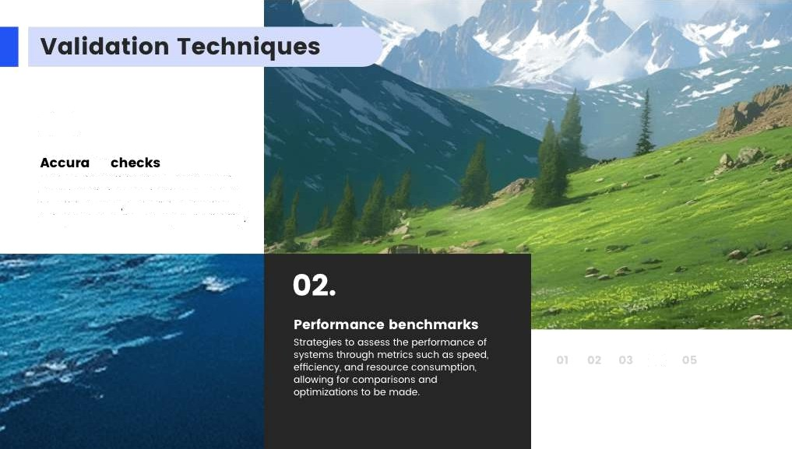
Methods for verifying the correctness of model predictions against known outputs. Identifying errors and refining algorithms to improve overall occuroc y and reliobility
04

Slide 21




Malnteno”nce
Handling bug repons
support channels
Regular updates ore crucial for software longevity. addressing security vulnerabilities, adding new features. and improving performance to ensure users have the best experience.
Handiing bug reports' involves receiving, categorizing, and prioritiz'ing issues reported by users. ensuring the'y ore addressed promptly anct'effecfively to maintain softwo re reliability.
User support channels are essential for providing assistance to users, including FAQs, forums, live chat and email support, to ensure they con resoJve issues anct enhance satisfaction.

